Slide 1
Using Spinal Cord Toolbox for image analysis
Irene Vavasour
Oct 1, 2025
UBC MRI Research Centre Monthly Analysis Meeting

Slide 2
Difficulties with spinal cord imaging and analysis
small size
13mm in diameter
deformable
cord can change shape depending on position of neck and head
motion
cord and CSF motion with heart pulsation
motion from swallowing
susceptibility
surrounded by bone and other organs
Lack of distinct features
hard to register since cord is mainly a simple cylinder so levels are not distinct

Slide 3

Spinal Cord Toolbox (SCT)
open-source command-line tools for spinal cord MRIs
created by Dr. Julien Cohen-Adad’s group (PolyLab) at Ecole Polytechnique de Montreal
latest release version 7.1
works on Linux, macOS and Windows
Reference: De Leener B, Lévy S, Dupont SM, Fonov VS, Stikov N, Louis Collins D, Callot V, Cohen-Adad J. SCT: Spinal Cord Toolbox, an open-source software for processing spinal cord MRI data. Neuroimage. 2017 Jan 15;145(Pt A):24-43.
Website: https://spinalcordtoolbox.com/stable/

Slide 4
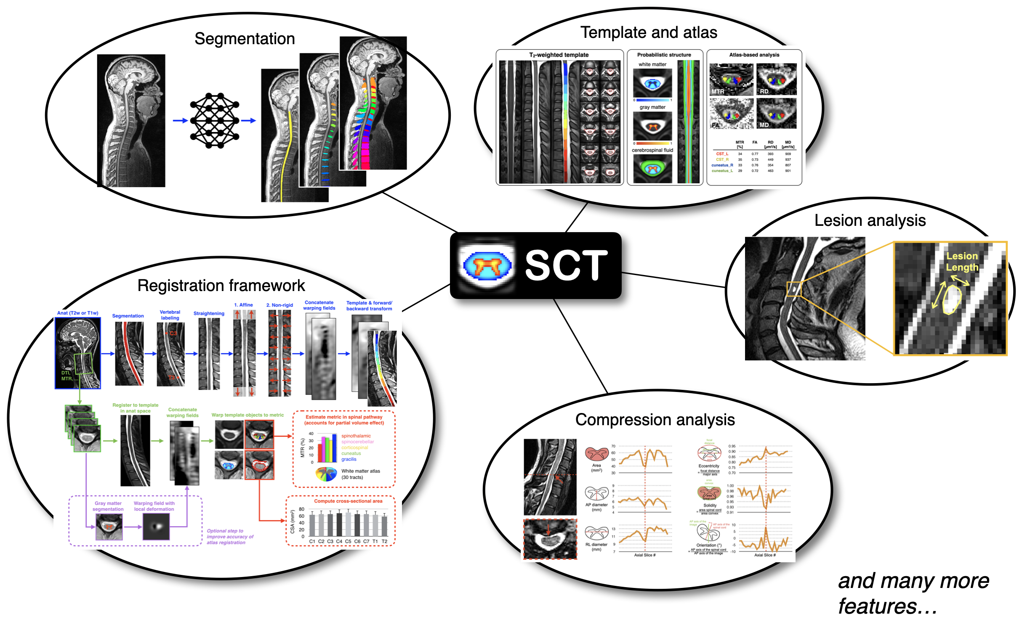

Slide 5
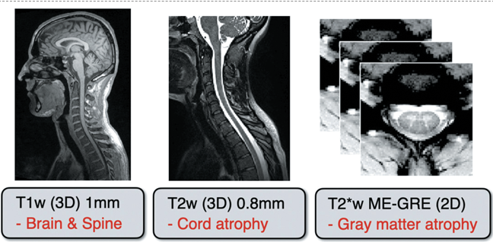
Best acquisitions for SCT
T₂ - shows good contrast between cord and CSF
T₁ and T₂* can also be used in some pipelines
SCT is trying to develop contrast agnostic tools

Slide 6
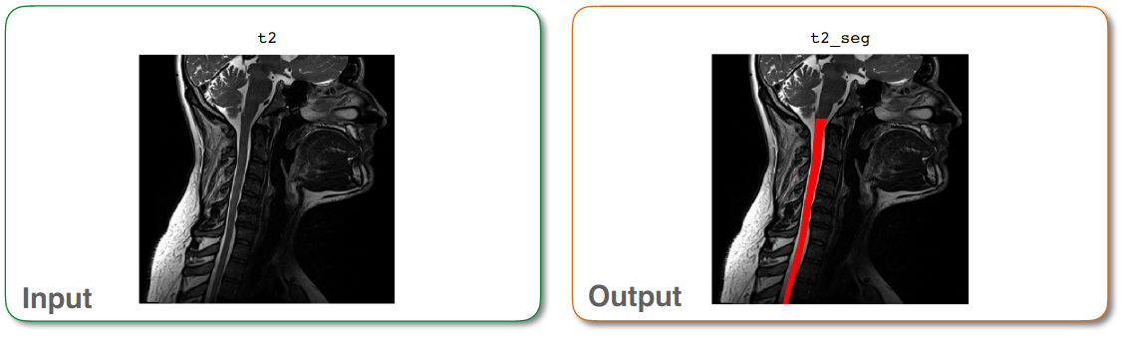
Segmentation
usually done on T₂w images
but can use other contrasts although cross sectional area (CSA) may differ if using different contrasts (although this is becoming less of a problem with newer tools)
command is sct_deepseg
example: sct_deepseg spinalcord -i t2.nii.gz -qc ~/qc_singleSubj

Slide 7
Segmentation
sct_deepseg spinalcord -i t2.nii.gz -qc ~/qc_singleSubj
can replace spinalcord with
graymatter
lesion
rootlets
…
SCT uses a deep learning model to do the segmentation
can see info on model with deep_seg -task-details

Slide 8
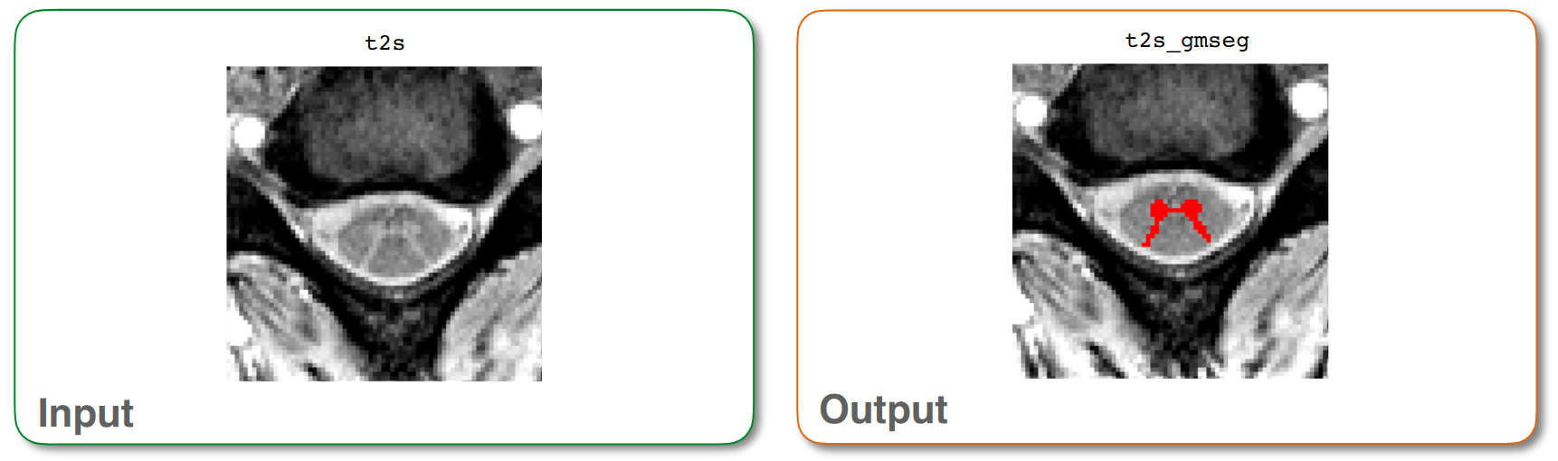
Grey Matter segmentation
uses a slightly different algorithm
sct_deepseg_gm
example
sct_deepseg_gm -i t2s.nii.gz -qc ~/qc_singleSubj

Slide 9
White Matter Segmentation
subtract the GM from the whole cord segmentations
sct_maths -i t2s_seg.nii.gz -sub t2s_gmseg.nii.gz -thr 0 -o t2s_wmseg.nii.gz

Slide 10
Lesion Analysis
segment (in SCT v7.0 or higher) with
sct_deepseg lesion_sci_t2 (for spinal cord injury)
sct_deepseg lesion_ms (for MS lesion)
sct_deepseg lesion_ms_axial_t2 (for MS lesion on T2 axial images)
sct_deepseg lesion_ms_mp2rage (for MS lesion on cropped mp2rage)

Slide 11
Lesion analysis
After segmentation, can do morphometric measures
eg. volume, length, max diameter, width, …
command:
sct_analyze_lesion -m t2_lesion_seg.nii.gz -s t2_sc_seg.nii.gz -qc qcname
can also do template analysis of lesions
proportion of ROI occupied by lesion
proportion of lesion within each vertebral level or tract

Slide 12
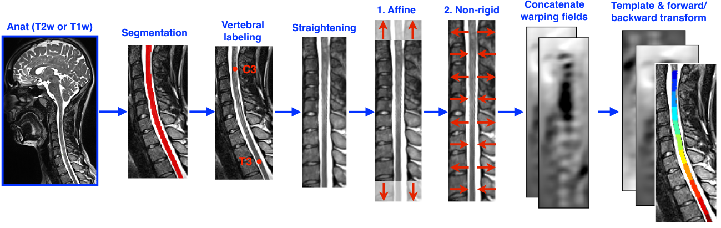
Registration to PAM50 template

Slide 13
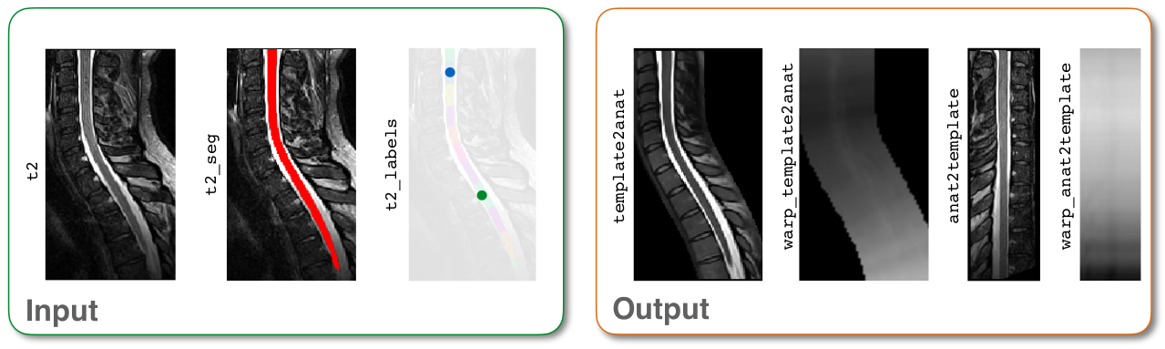
Registration
sct_register_to_template
This algorithm does:
straightening
vertebrae-matching transformation
shape matching transformation
example:
sct_register_to_template -i t2.nii.gz -s t2_seg.nii.gz -l t2_labels_vert.nii.gz -c t2 -qc ~/qc_singleSubj

Slide 14
Vertebral Labelling
Needed for registration step
labels are placed as though the vertebrae were projected onto the spinal cord, with the label centered in the middle of each vertebral level
sct_label_vertebrae automatically labels
example: sct_label_vertebrae -i t2.nii.gz -s t2_seg.nii.gz -c t2 -qc ~/qc_singleSubj
This step sometimes fails so need to manually label C2-C3 level

Slide 15
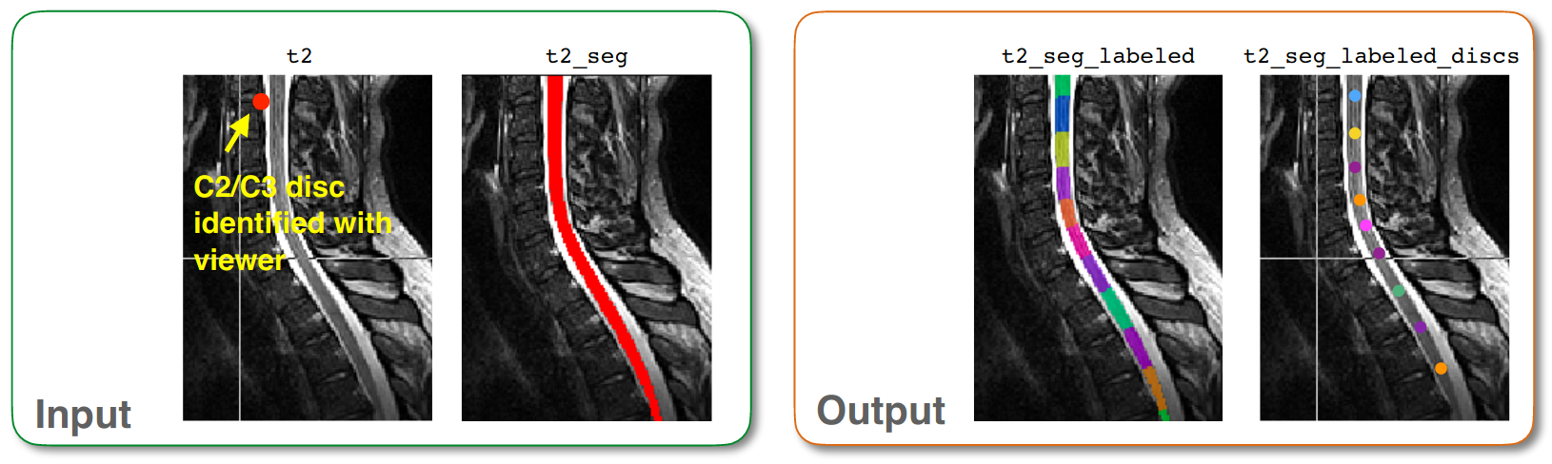
Manual Vertebral Labelling
sct_label_utils -i t2.nii.gz -create-viewer 3 -o label_c2c3.nii.gz \
-msg "Click at the posterior tip of C2/C3 inter-vertebral disc“
sct_label_vertebrae -i t2.nii.gz -s t2_seg.nii.gz -c t2 -initlabel label_c2c3.nii.gz -qc ~/qc_singleSubj

Slide 16
Registration
can customise the registration with arguments
Default values for '-param’ argument
-param step=1,type=imseg,algo=centermassrot,metric=MeanSquares,iter=10,smooth=0,gradStep=0.5,slicewise=0,smoothWarpXY=2,pca_eigenratio_th=1.6:step=2,type=seg,algo=bsplinesyn,metric=MeanSquares,iter=3,smooth=1,gradStep=0.5,slicewise=0,smoothWarpXY=2,pca_eigenratio_th=1.6
-ref argument
select destination for registration: template or subject space

Slide 17
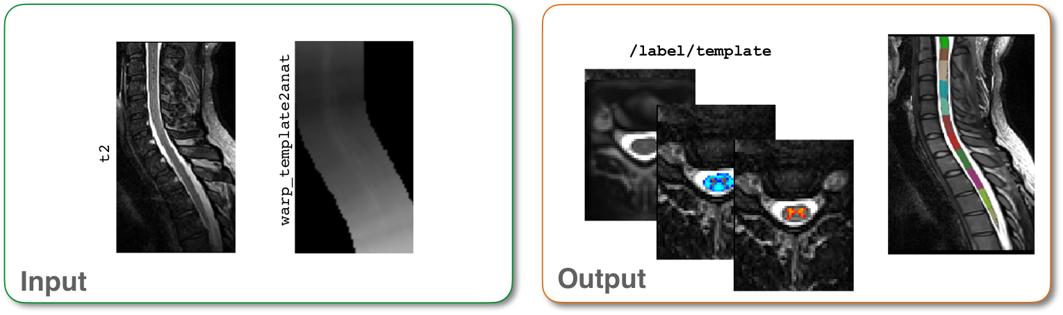
Registration
After finding transformation between subject and template space, can use warp field to move template to subject space
sct_warp_template -d t2.nii.gz -w warp_template2anat.nii.gz -a 0 -qc ~/qc_singleSubj

Slide 18
Registration
Can co-register other quantitative images to the template
segment the quantitative image - sct_deepseg
create mask around segmentation - sct_create_mask
registration to template
option 1: reuse warping field - sct_register_multimodal
option 2: direct registration to template
sct_label_utils
sct_register_to_template
now warp template to subject space - sct_warp_template

Slide 19
Computing CSA
To compute the cross sectional area (as well as some other parameters) use
sct_process_segmentation -i t2_seg.nii.gz -vert 2:3 -vertfile ./label/template/PAM50_levels.nii.gz -o csa_c2c3.csv

Slide 20
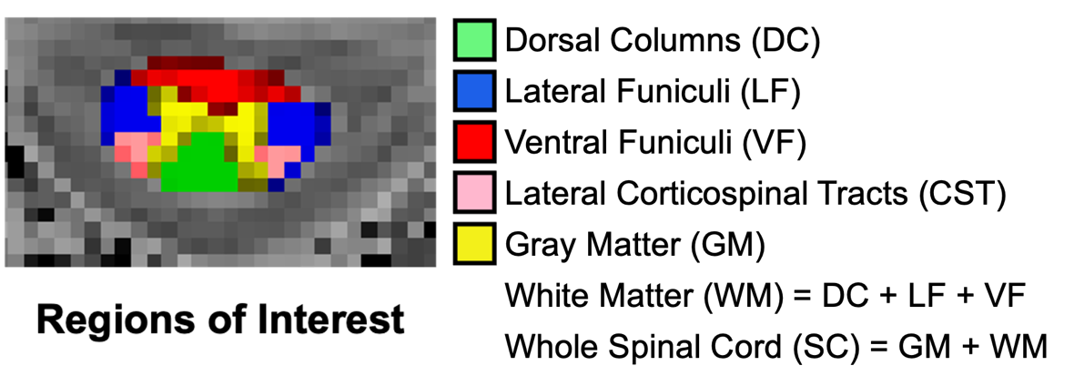
Computing quantitative measures
After registering the template to the quantitative imaging space can use
sct_extract_metric -i mtr.nii.gz -f label/atlas -method map -l 51 -o mtr_in_wm.csv
-l refers to which ROIs will be used
50: whole cord
51: WM
52: GM
53: dorsal column
54: lateral funiculi
55: ventral funiculi

Slide 21
Another good reference
Jan Valošek, Julien Cohen-Adad, Reproducible Spinal Cord Quantitative MRI Analysis with the Spinal Cord Toolbox, Magnetic Resonance in Medical Sciences, 2024, Volume 23, Issue 3, Pages 307-315.
up-to-date review on how best to collect and analyse spinal cord data

Slide 22
Next Meeting
Wednesday Nov 5th
3:15-415
Topic: ???

